Slide 1
New Metadata Integrity Standard Operating Procedure For Broken URLs
FGP DWC Meeting
June 2020

Slide 2
Broken links Standard Operating Procedure
1. Problematic
2. Objectives
3. Proposed Solution
4. Operation
5. Communication
6. Milestones

Slide 3
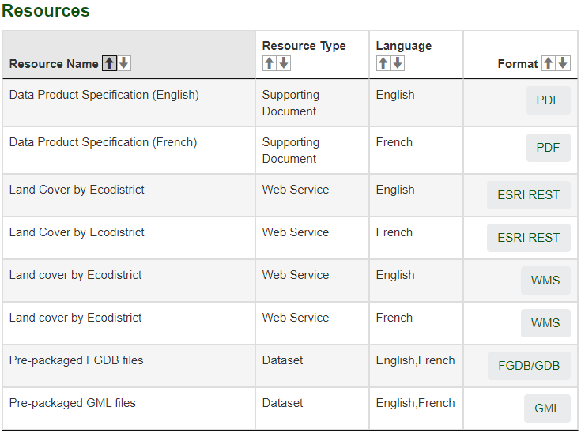
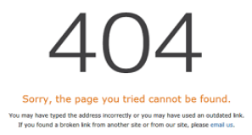


1. Problematic
No process in place to detect invalid links to map resources or data once datasets are published
OSDP emergence brought up the extent of the problem
Broken links affecting the map resources can sometimes affect the “View on Map” capability

Slide 4
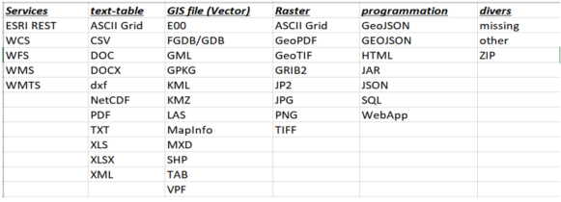
2. Objectives
Establishment of a detection system for the bad links
(The FGP is not involved with the rectification of the problems)
Implantation of a communication mechanism to reach the datasets owners
Incremental development starting with WMS/ESRI REST map resources links
(45 different formats and resource types available in the metadata)

Slide 5


3. Proposed Solution
Automatic system for the detection of broken links and the communication of results using the FME Server application.
Generic development and solutions are favored because of the large number of formats currently available and the ones to be in the future.
Follow this development on our GitHub page
https://github.com/federal-geospatial-platform/DataTeamSoftwares

Slide 6
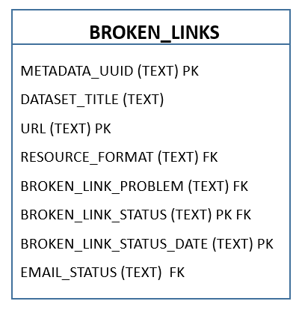
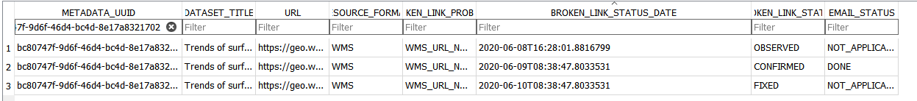
4. Operation (basic facts)
Validation will be performed on a weekly basis
Database will be used to store all broken URL problems
Data model allows multiple problem status
OBSERVED → New broken URL problem
CONFIRMED → Observed broken URL problem redetected
FIXED→ Broken URL problem
Notifications will be sent when status changes from Observed to Confirmed

Slide 7
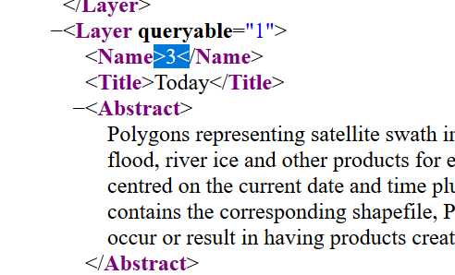
4. Operation (implementation)
Validation is format dependant (WMS, SHP,…)
Iterative implementation process
Don’t need to have file format validation to start validate database
WMS and ESRI:REST validation will be implemented first
WMS validation includes
URL definition (?service=wms&query=GetCapabilities)
URL returns
Layers validation (&layers=3)

Slide 8
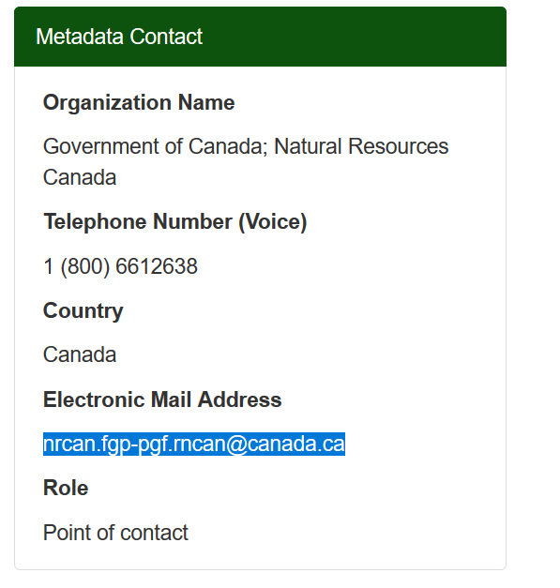
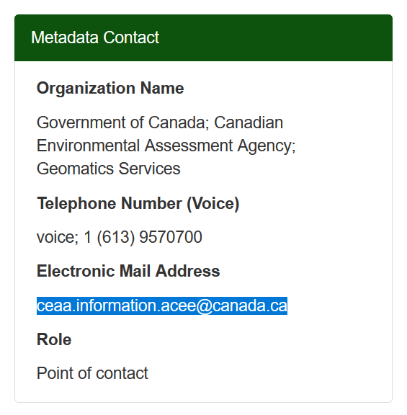
5. Communication
Email will be automaticly sent to the Metadata Contact (new confirmed problem)
Email format not defined yet, minimal information
URL
Metadata ID
Date
Possible remider (if needed) for too old CONFIRMED problems
Data contributor will have all information to fix the problem ☺

Slide 9
6. Milestones
Conception and analysis - Ongoing
Development of basic system components + OGC WMS/ESRI REST format: July-August
Catalogue connection
Broken links management
Email notification
Test and deployment – Fall
Other formats will follow gradually – End of fiscal year

